Slide 1
Virtual Operations

Slide 2
Davis

Slide 3
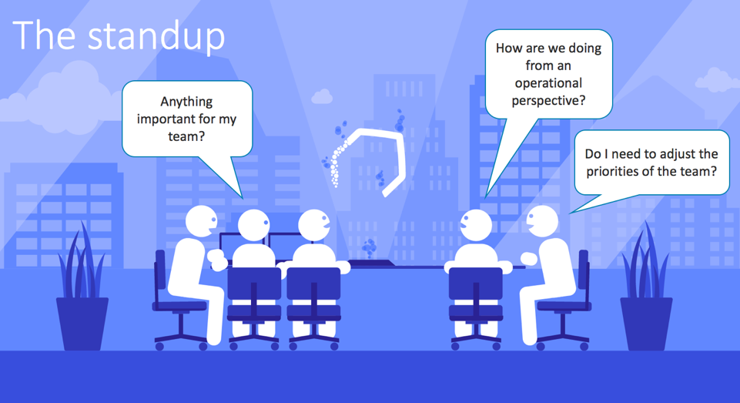
Notes:
When we started with Davis 2 years ago, the hype around natural language processing was just starting
We had two personas in mind
Operations teams get a virtual team member, that answers technical questions through a conversational interface and serves as starting point to drill deeper into problems if there are any.
Executives get a virtual assistant, that answers them high level questions about overall application health. Without the need to log in to the product, Davis blends right into their daily routines and all it takes is to ask Davis for a report.

Slide 4
Since last Year

Slide 5
Davis is available for everyone!
For Free!
Just visit davis.dynatrace.com
Notes:
This means any one can go to davis.dynatrace.com

Slide 6
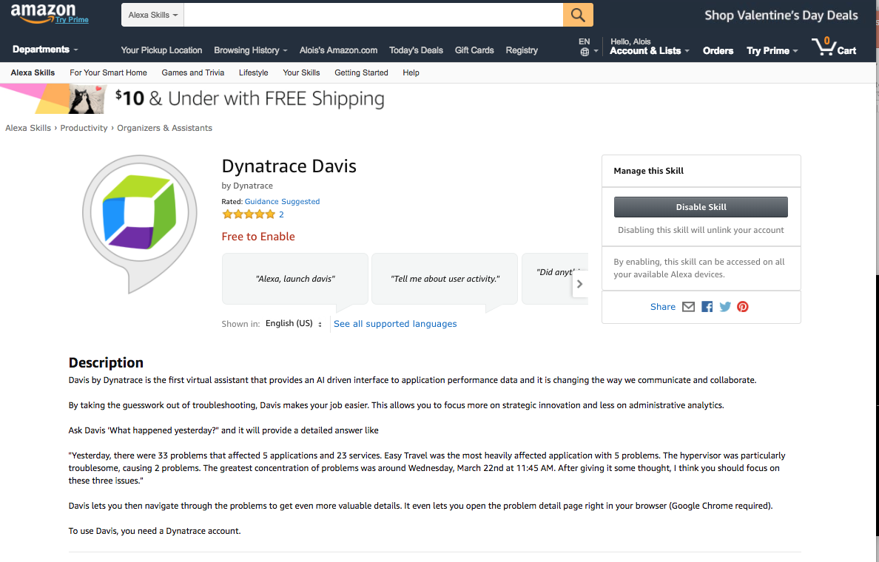
Notes:
It's also available as Alex app.
So you can install it to any Echo Device
You will automatically be sent to Dynatrace to link your account and you are done

Slide 7
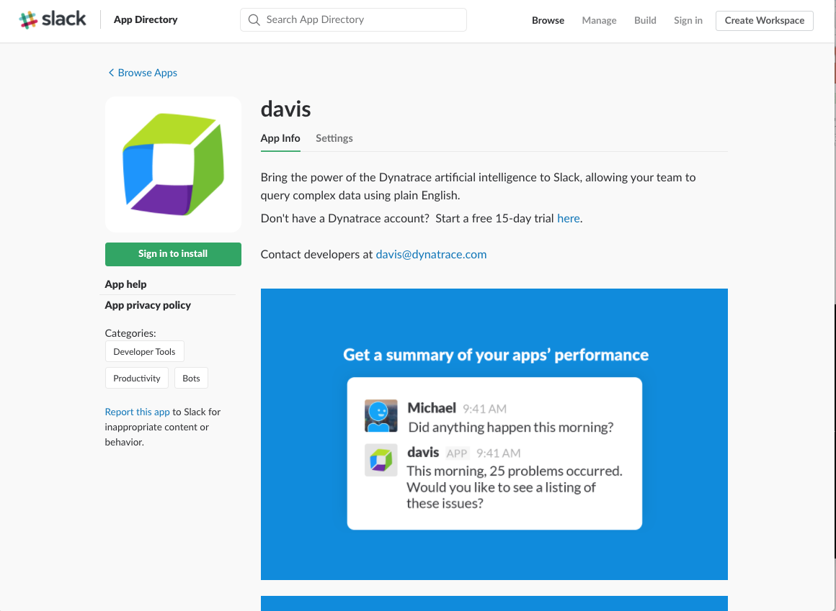
Notes:
The same is true for Slack.
Simply install the slack to your organization, link accounts ... done

Slide 8
800
Connected Environments

Slide 9
500
Active Users

Slide 10
10k
Interactions/Month

Slide 11
“Every time I use Davis, I gain 5 minutes back in my life, instead of searching for the answer to the problem”
– Devonte Emokpae, Head Of Development at Doctify
“With Davis we have seen a 30% increase in users adopting Dynatrace. By using voice, it’s a quick and fast way for people to interact, ...”
– Jeppe Lindberg, Practice Lead at RedOcean
“Our senior leaders don't want to log into Dynatrace. Davis is the perfect solution to give executives critical information immediately.”
– Mary Farrell, United Health Group
Notes:
Here is what our customers are saying

Slide 12
Since late 2017

Slide 13
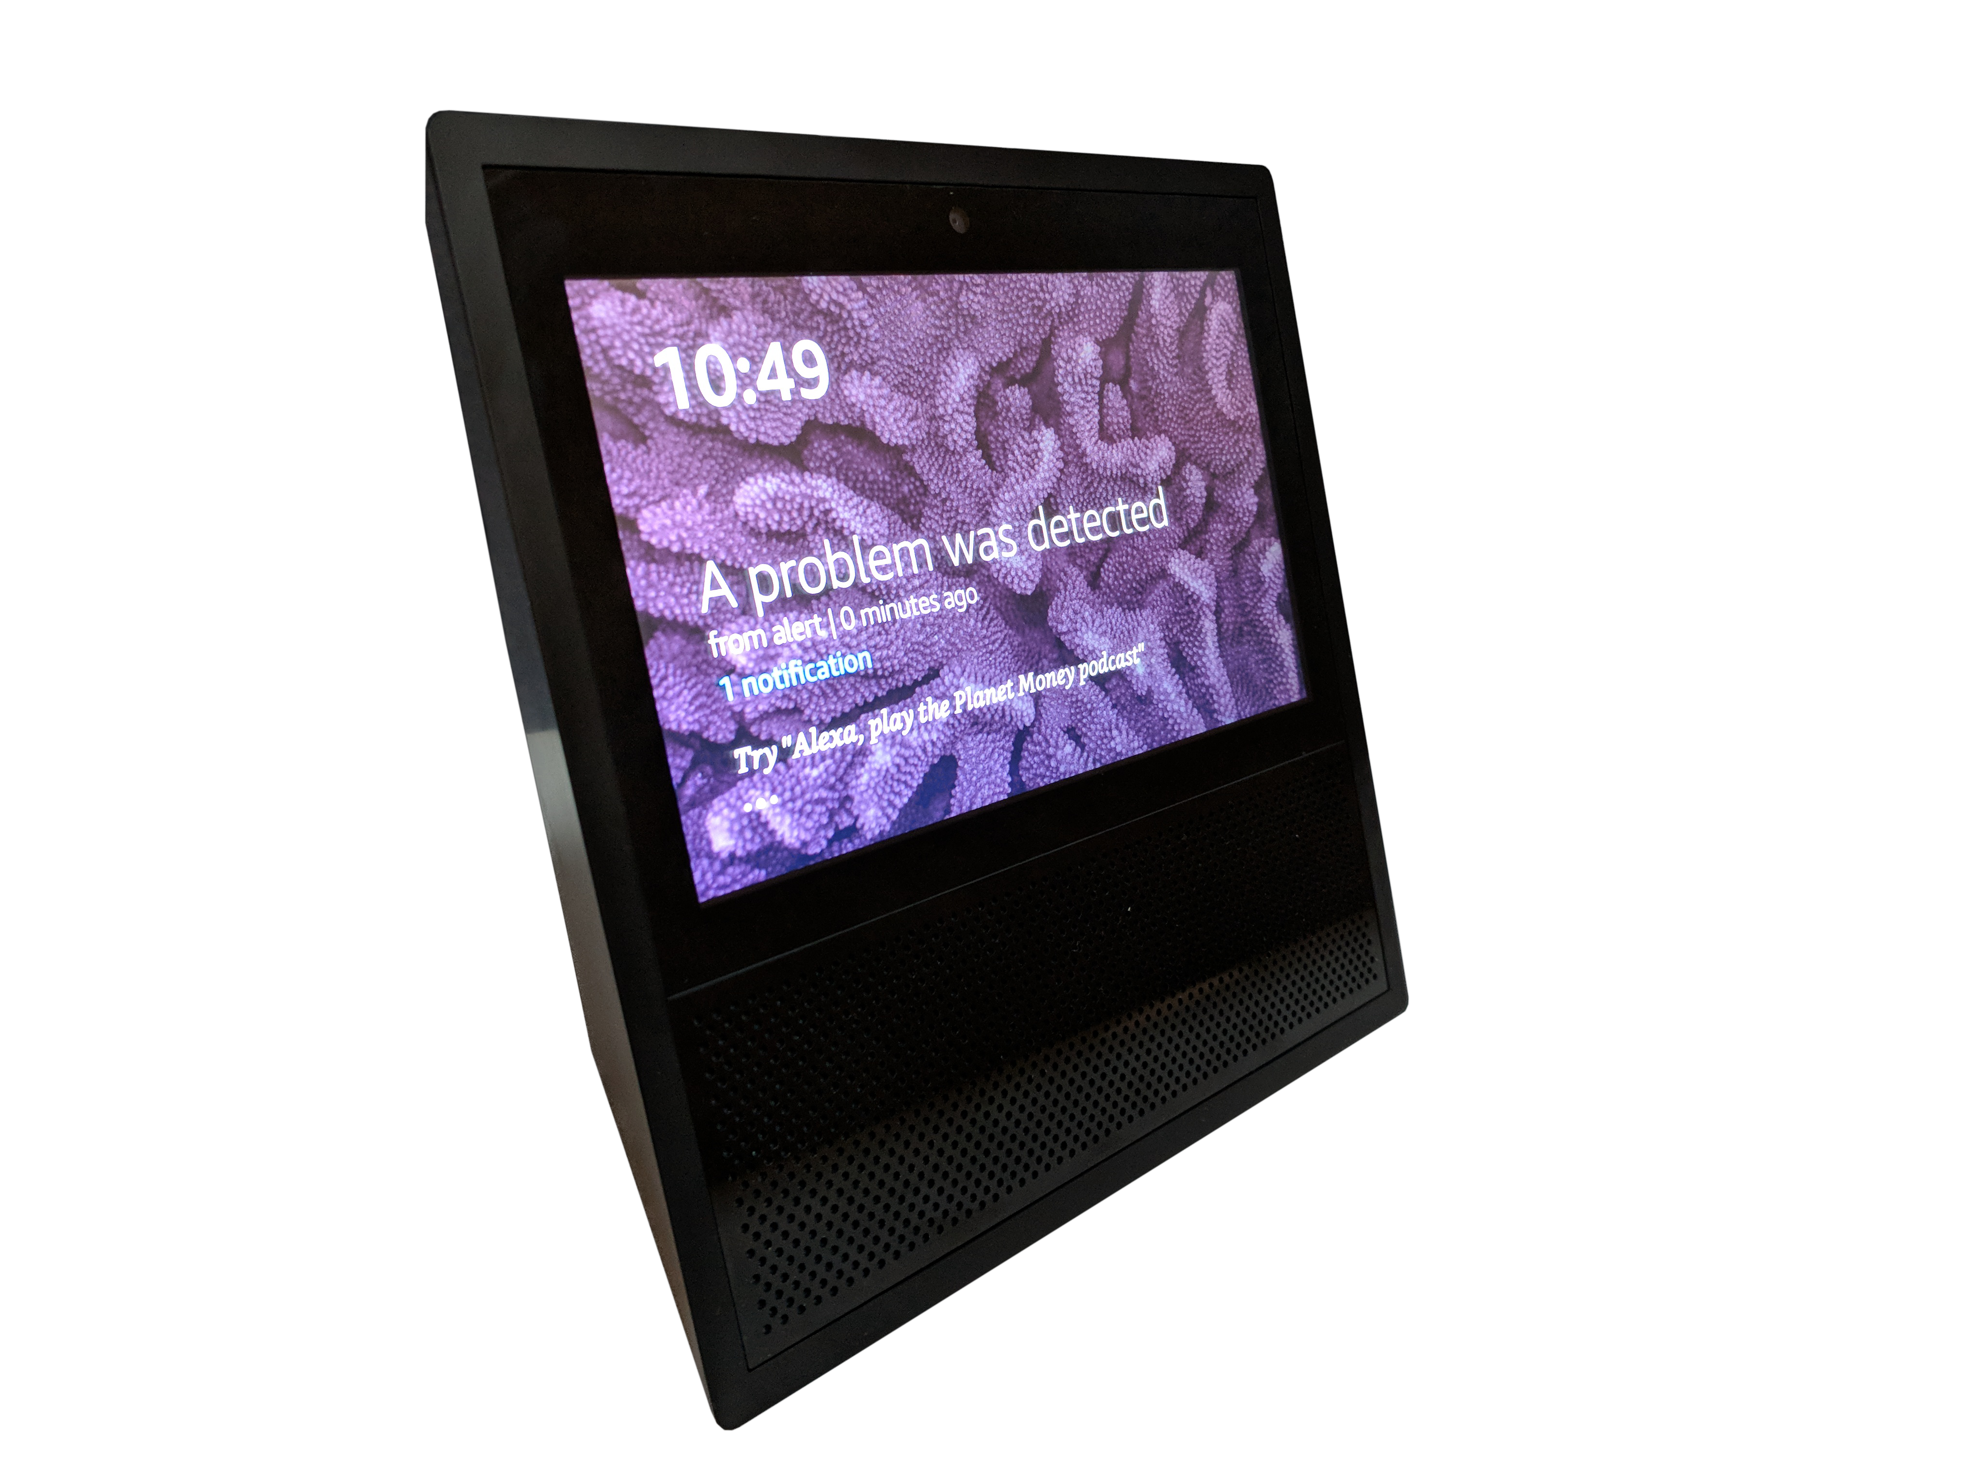
Notifications for Amazon Echo and Slack
Notes:
We were one of the first Alexa apps that got to use this new feature

Slide 14
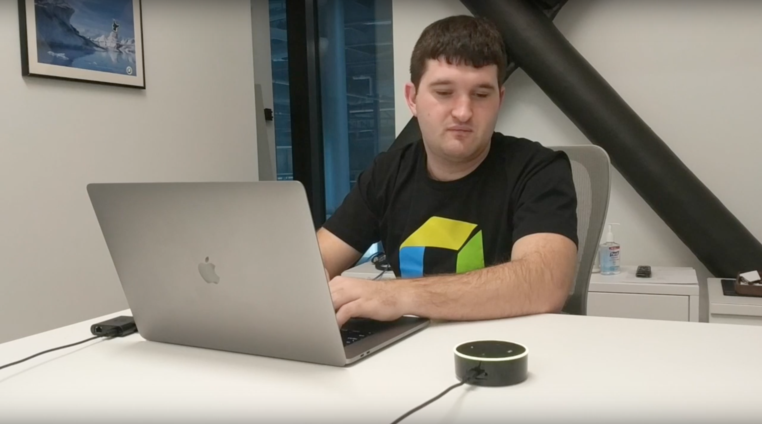

Slide 16
2018
Notes:
Now in 2018 ...

Slide 17
Davis becomes your #1 Natural Language Plattform
Notes:
What do I mean with that

Slide 18
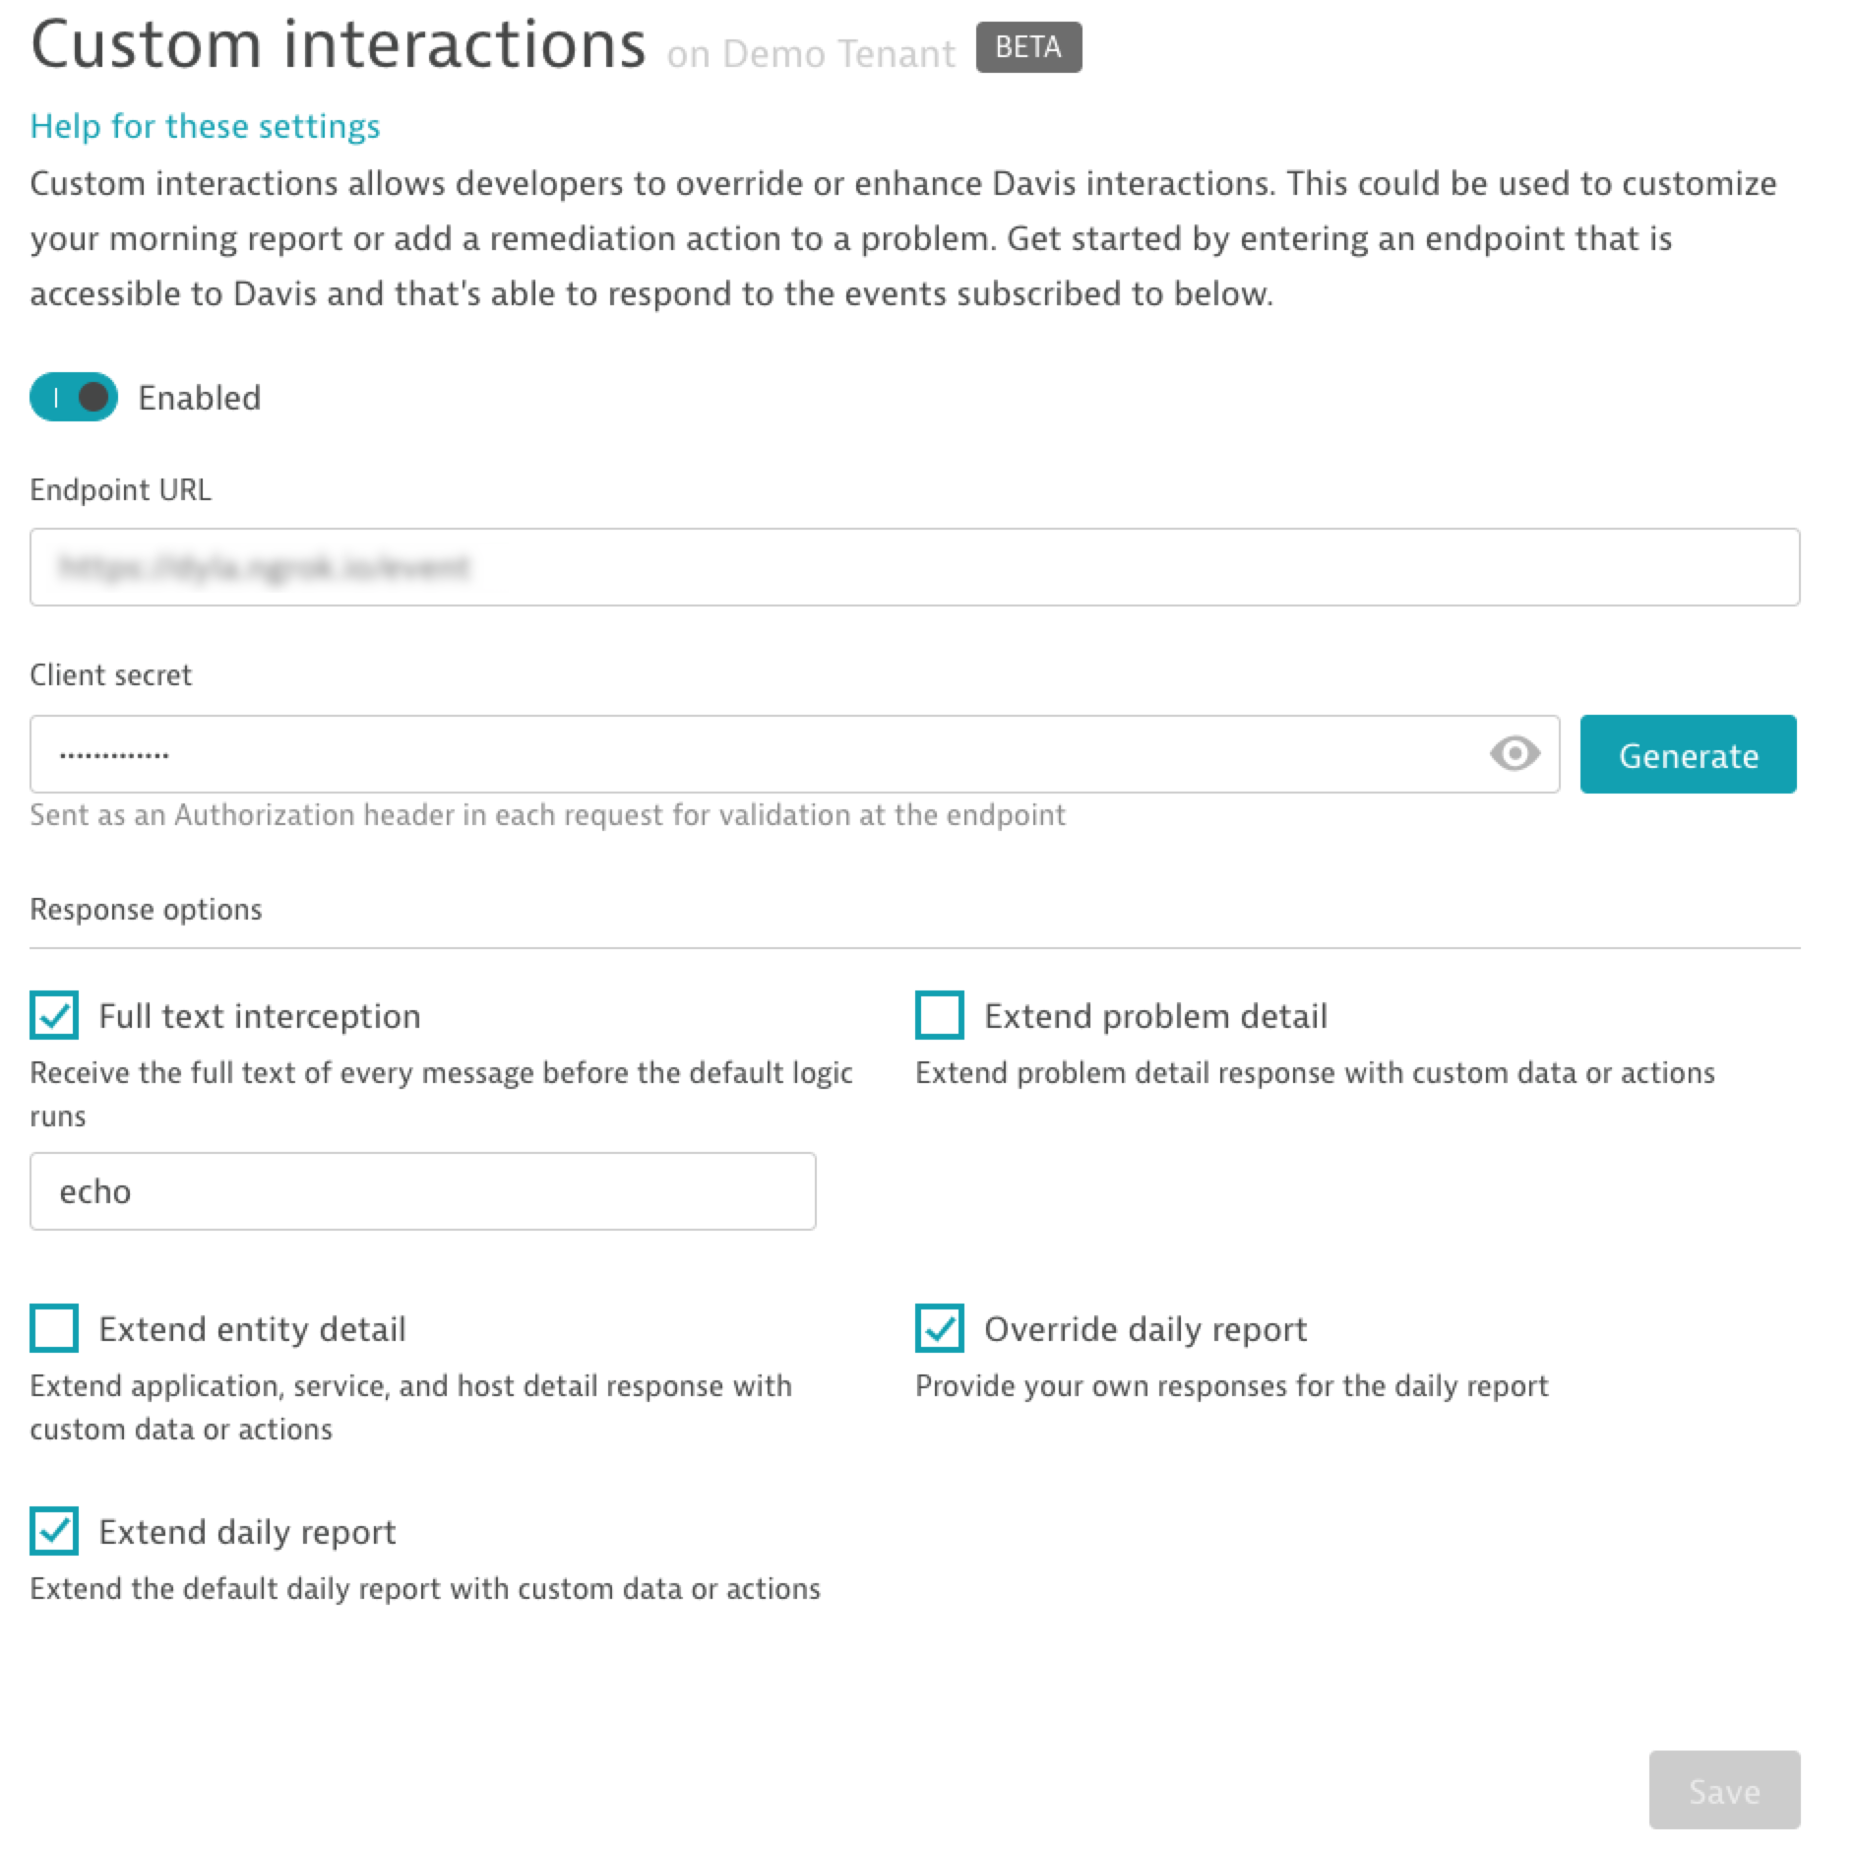
Notes:
We now have custom interactions ... that means that you can add your own hooks to davis.
You can extend and annotate problem details, add new answers, add new actions and buttons.
With that it's possible to trigger very specific events LIKE REDEPLOYS OR ROLLBACKS directly via davis.
Again - also think of slack here.

Slide 19
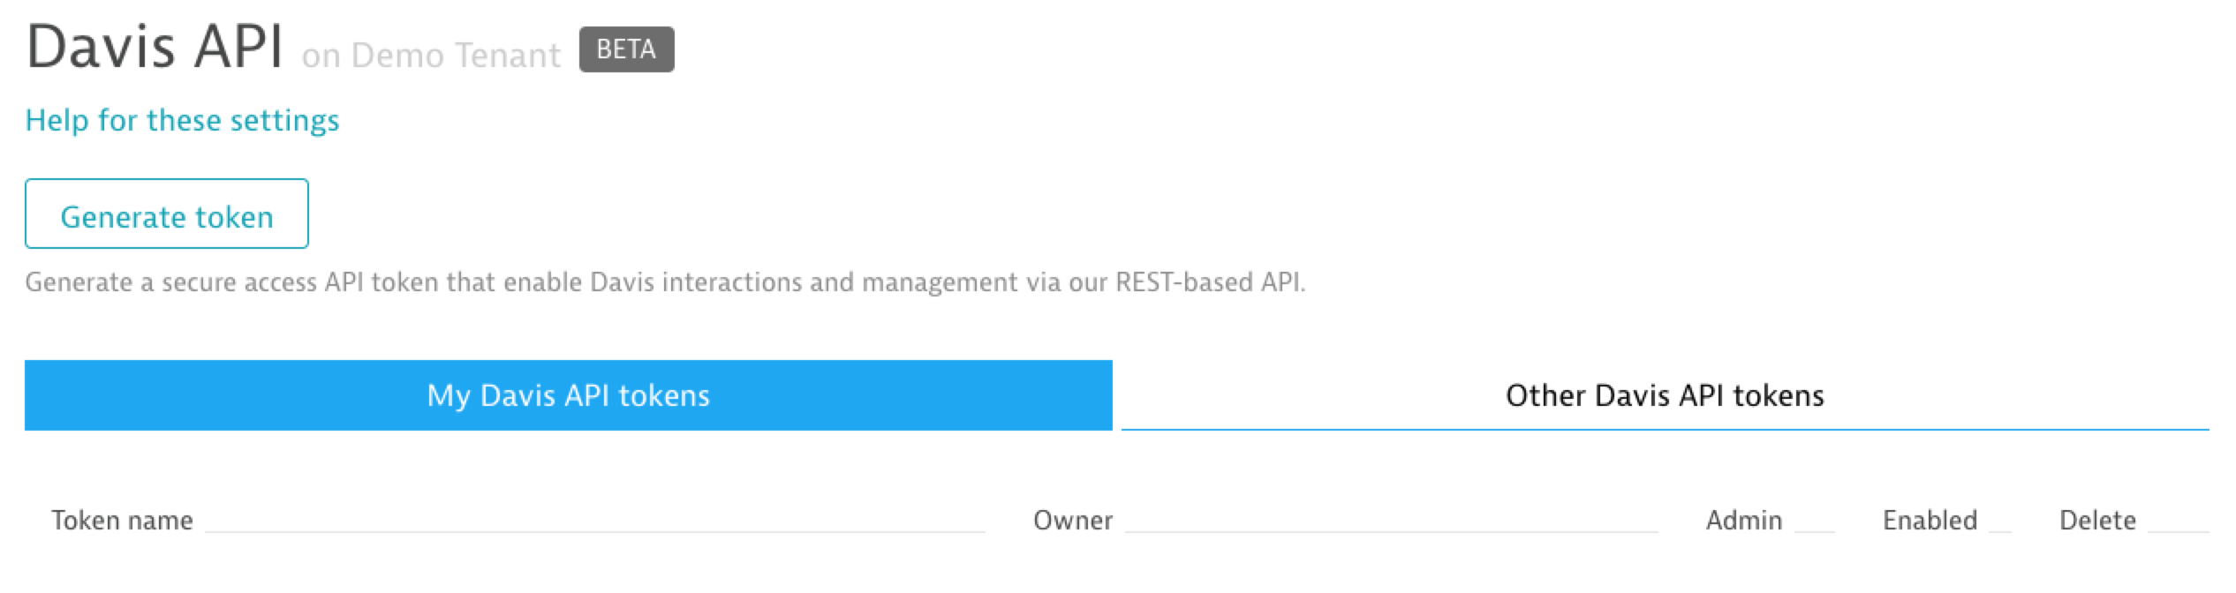
Notes:
ADDITIONALLY WE added an API - with this API you can create your own frontends or apps that use davis as backend.
Like some internal chat tool that we don't integrate with.

Slide 20
NEXT!

Slide 21
Add more phrases and interactions
Extend the flows by using a new NLP engine
Integrate Davis deeper into the main product

Slide 22
Hands On

Slide 23
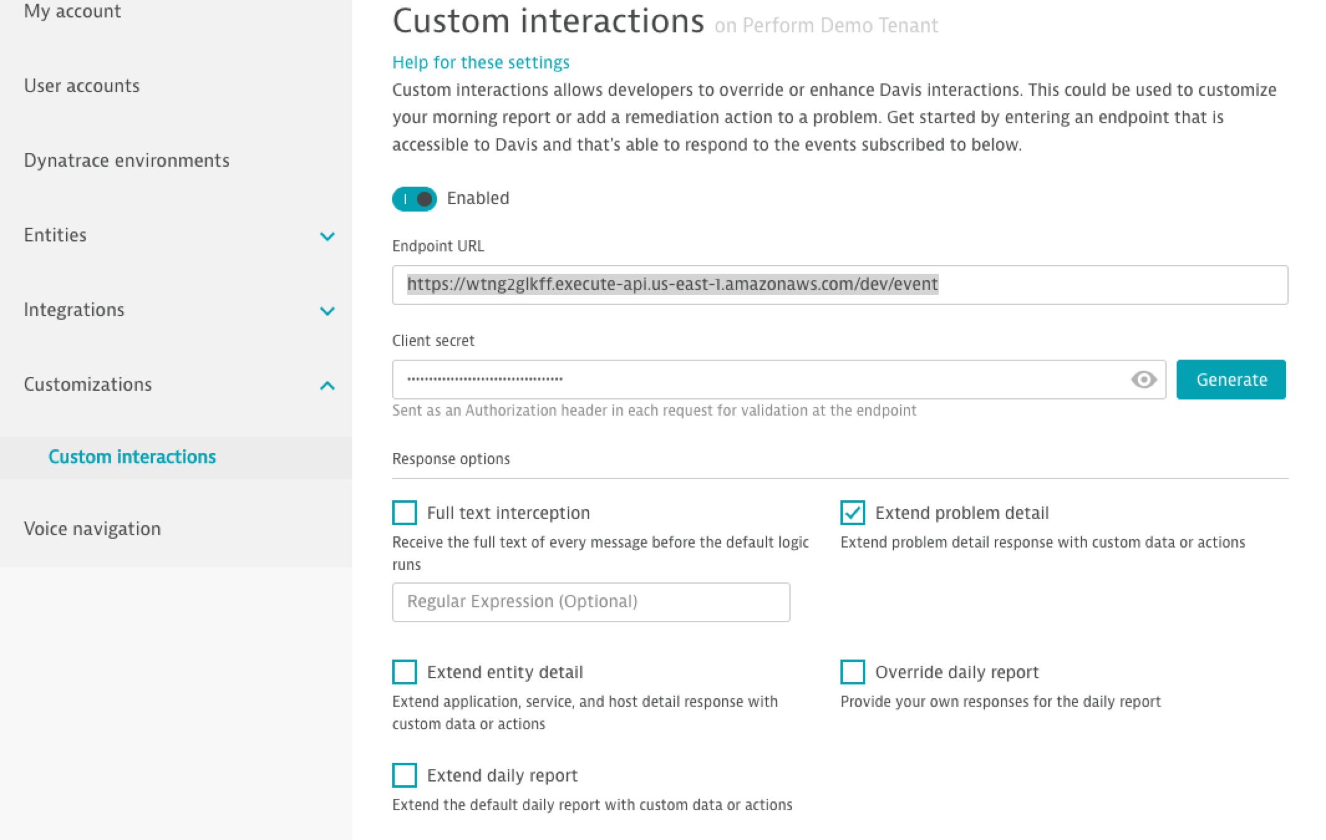
Extend Davis
git clone https://github.com/Dynatrace/davis-custom-interaction-examples.git
cd express
npm install
Install ngrok
Run ngrok http 3000
Davis / Account Settings / Cusomizations
Set endpoint and extend problem detail
Extend Davis with a custom interaction

